Slide 1




SIH2020
PROBLEM:
Use satellite data and artificial intelligence to monitor crop production across India. Use standard dataset available from NASA/ISRO for this purpose. This kind of data will be helpful to predict production of crop with schedule and help government develop a procurement plan for the same.
Govt. of Bihar (DOA)

Slide 2
CENTRAL CREW
Maharaja Surajmal Institute of Technology
Anshuman Padhi
Anushka Jadhav
Tavneet Singh
Vimal Kumar Tripathi
Ishan Vohra
Yatan Srivastava

Slide 3
How are we solving the problem?
The solution requires us to predict the future yield of a crop in a particular district.
An android application and website reporting the findings and some other usable features will be helpful.

Slide 4
SOLUTION

Slide 5
FarmAid
A platform that helps govt. official to get insights over the future yields for their district to help them with better procurement and logistics with detailed statistics
Krishi Sahayta
A platform that helps farmers understand their crops choice and improve financial growth with simple, to the point observations.

Slide 6
VIDEO DEMONSTRATION

Slide 7
EXECUTION

Slide 8
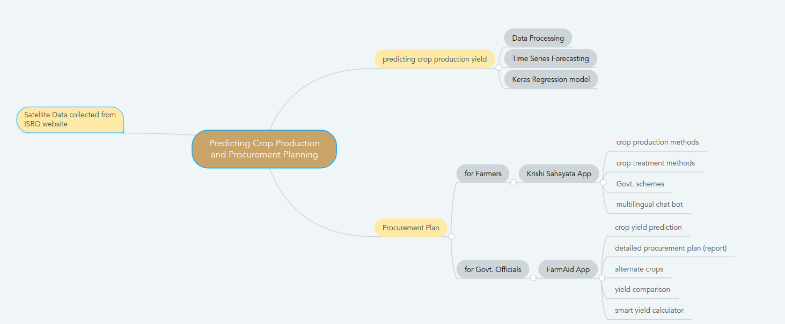
Execution Flow

Slide 9
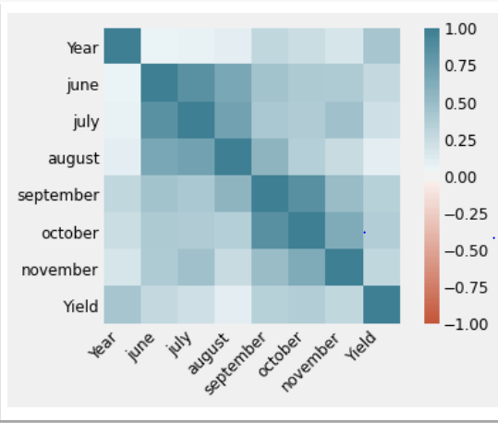
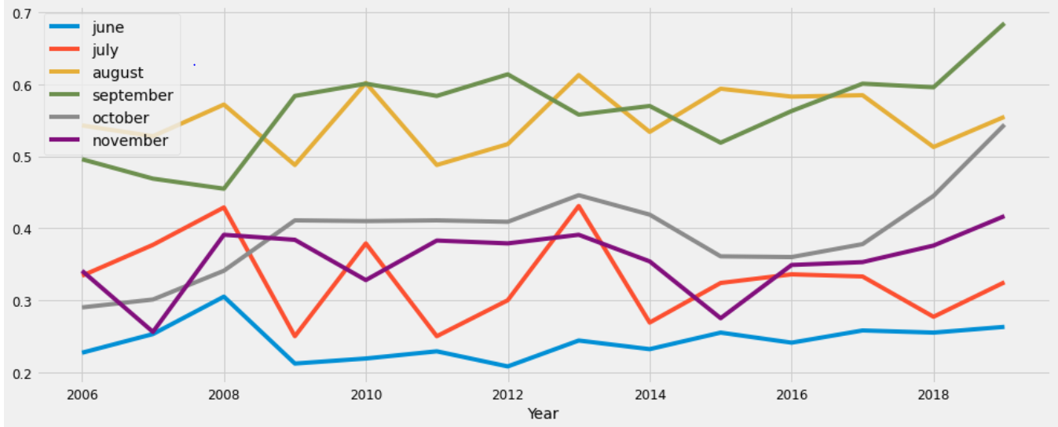
Machine Learning

Slide 10
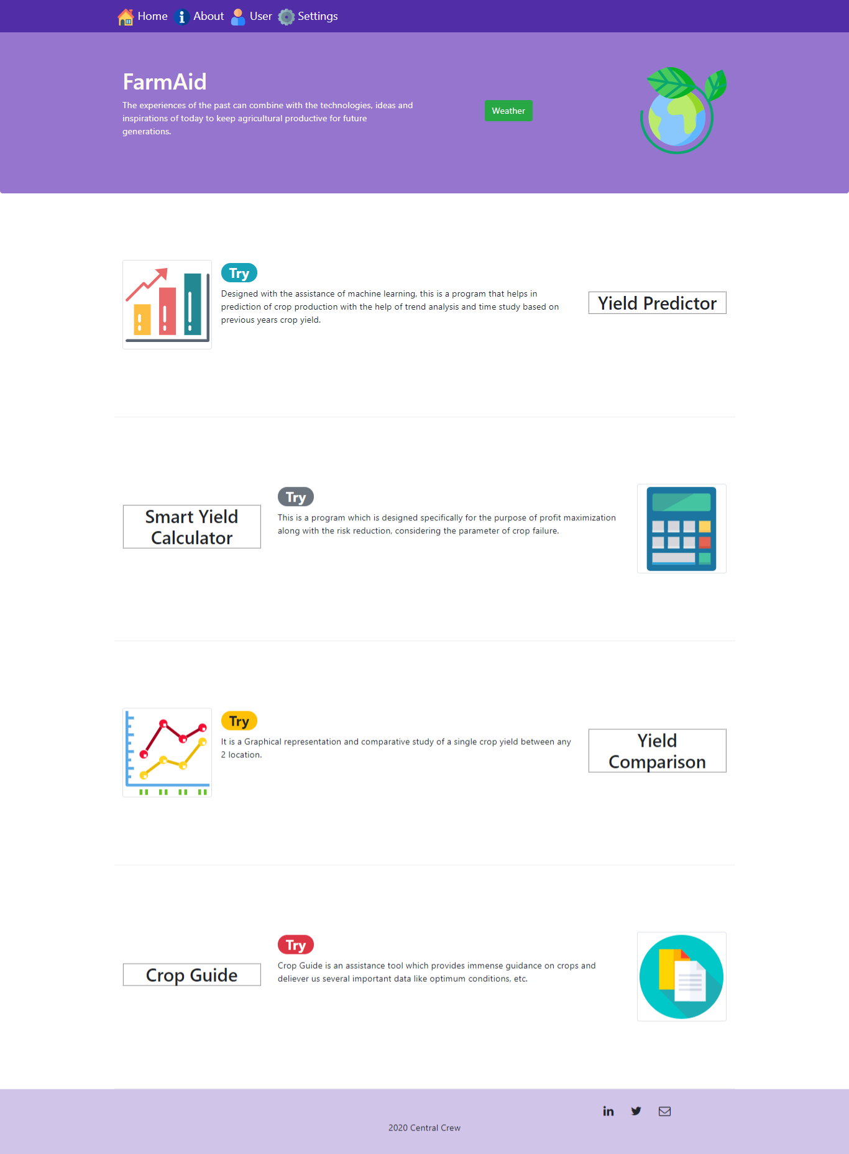
Website

Slide 11
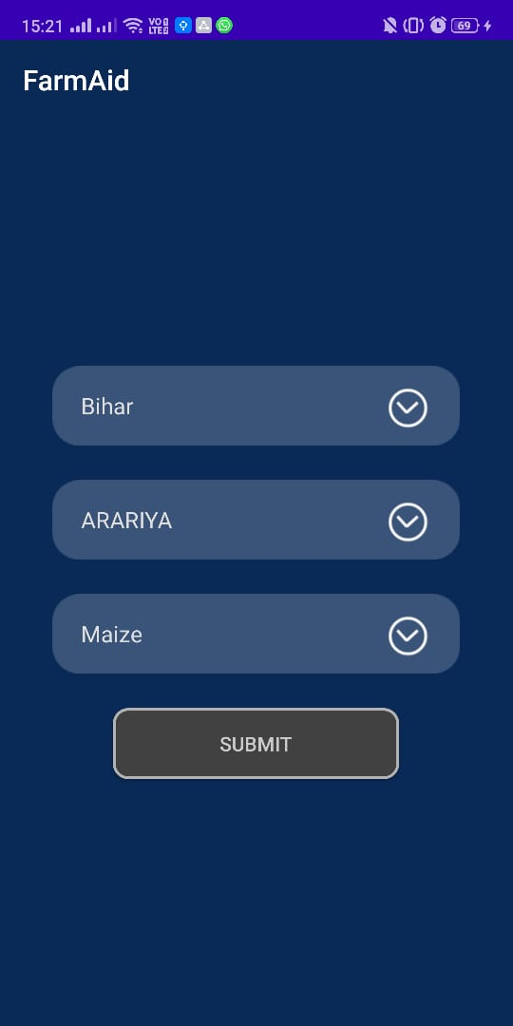
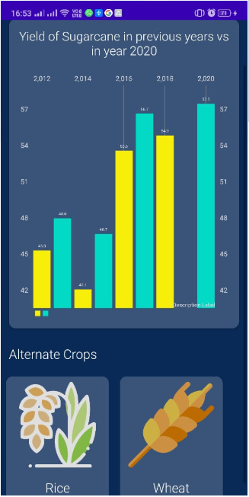
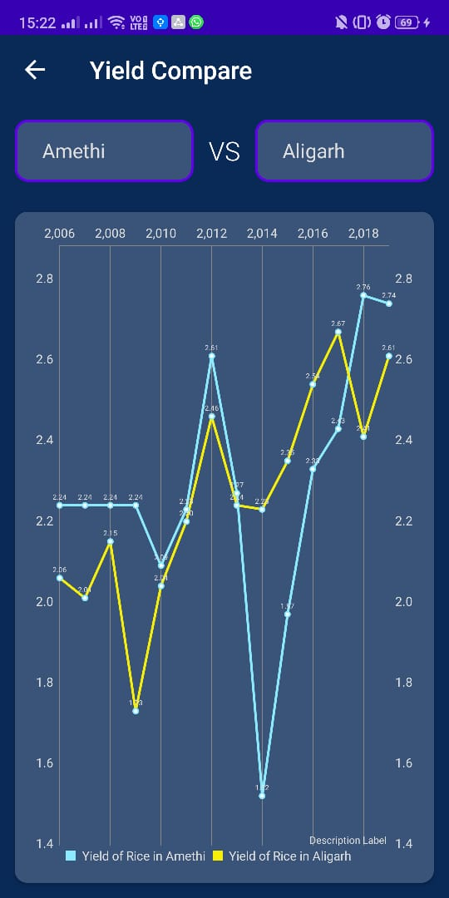
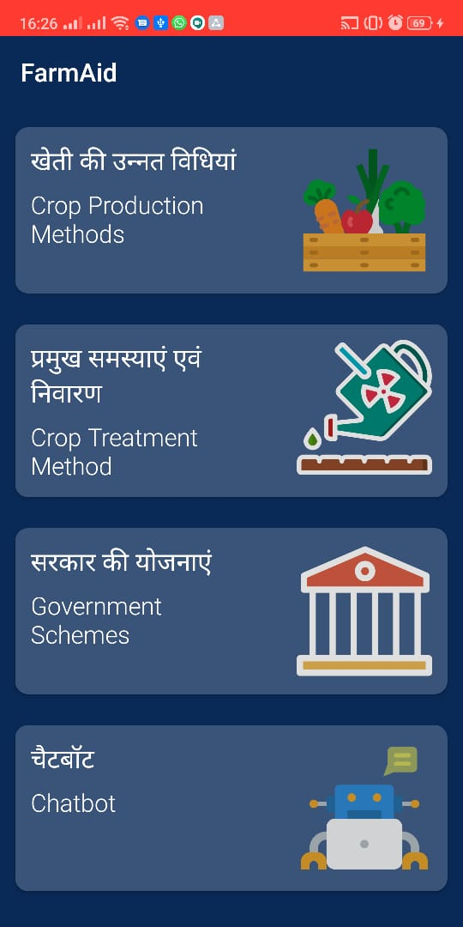
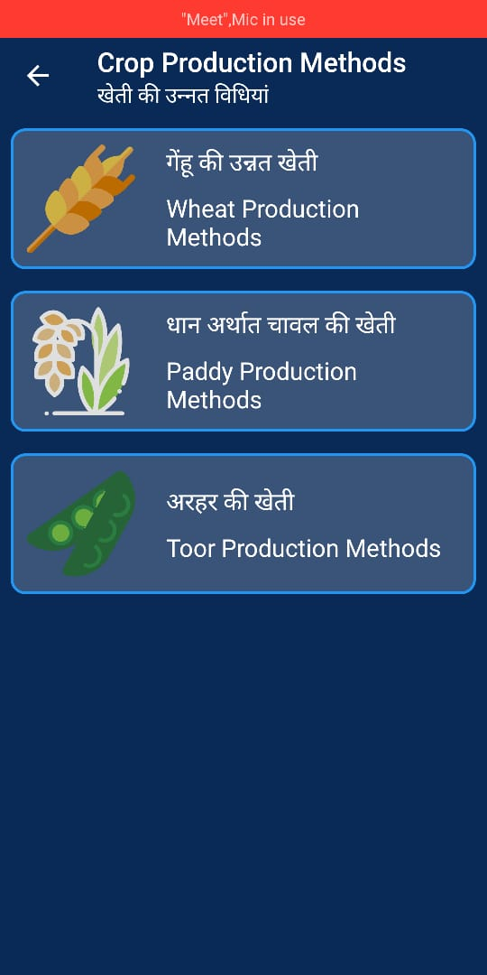
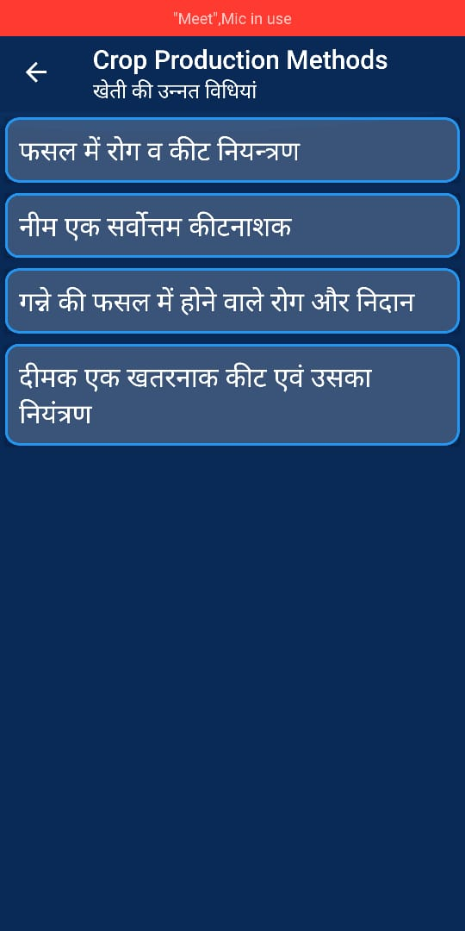
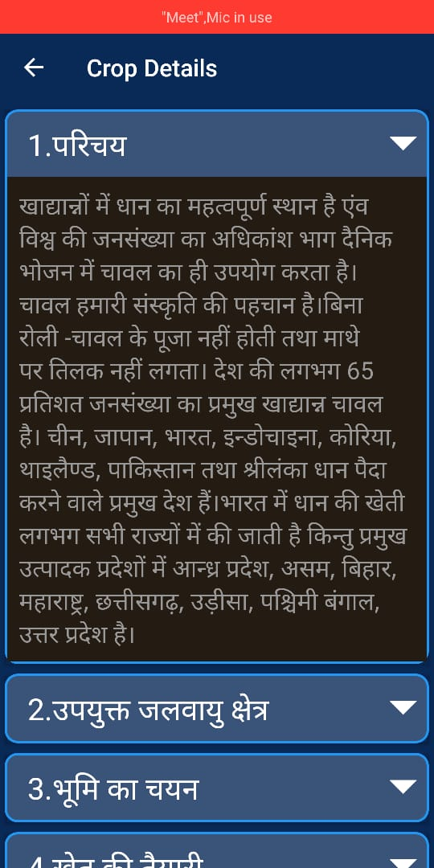
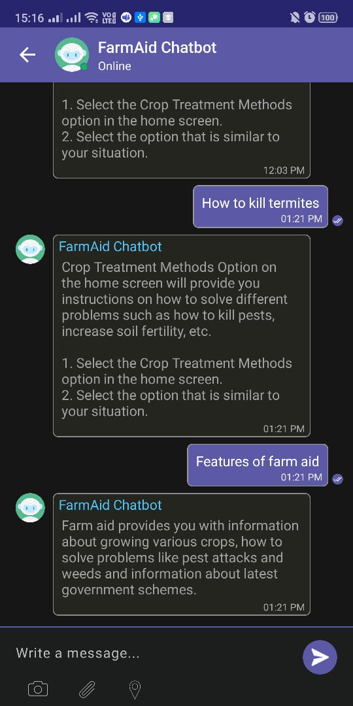
Android

Slide 12
IMPACT

Slide 13
Agriculture plays a vital role in the Indian economy with over 70% of rural households depending on it. It contributes about 18% of the total GDP and provides employment to over 60% of the population.
Crop monitoring can improve food security and help prevent famines and tackle climate change in India.
it's citizens and Our app will equip us better for a similar situation as the 5 months long lockdown currently, in the future.

Slide 14
SOLUTION APPEARANCE

Slide 15
SOLUTION APPEARANCE
The app is specifically designed on the suggestions of real farmers. E.g. font size, language, information required by them.
The features are intuitive and the order makes it easy to move forward step by step in real life.

Slide 16
TECHNOLOGY STACK

Slide 17



Machine Learning and AI
Python
Modules:
Scikit Learn
Tensorflow
Keras
Model:
Keras regression model
ARIMA model

Slide 18




Android
Android Studio
Firebase
Retrofit
Dialogflow kit

Slide 19




Website
HTML/CSS
Javascript
chart.js
Bootstrap
Postman
Flask

Slide 20
USER EXPERIENCE

Slide 21
USER EXPERIENCE
FarmAid:
The user interface provides elaborate statistical details and visualization for administrators.
For clerical employees a detailed report is generated to manage logistics like transport and warehousing.
Krishi Sahayta:
For farmers the user experience is simple intuitive and minimalistic to avoid any information overload with precise intel.
Tools in the app help farmers understand the future situation and take smart decisions.
Helplines, govt. policies and chatbot will help the farmers during the whole crop cycle.

